Slide 1



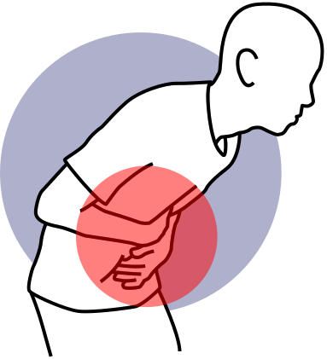
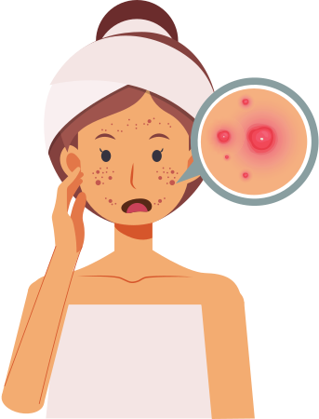
Medicologi.com
TYPHOID FEVER
EXPLAINED

Slide 2



Medicologi.com
Two Types of Typhoid
TYPHOID FEVER
PARATYPHOID FEVER
is primarily caused by the bacterium Salmonella Typhi.
Paratyphoid fever is caused by a different strain of Salmonella bacteria called Salmon

Slide 3

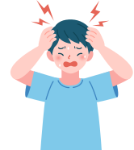

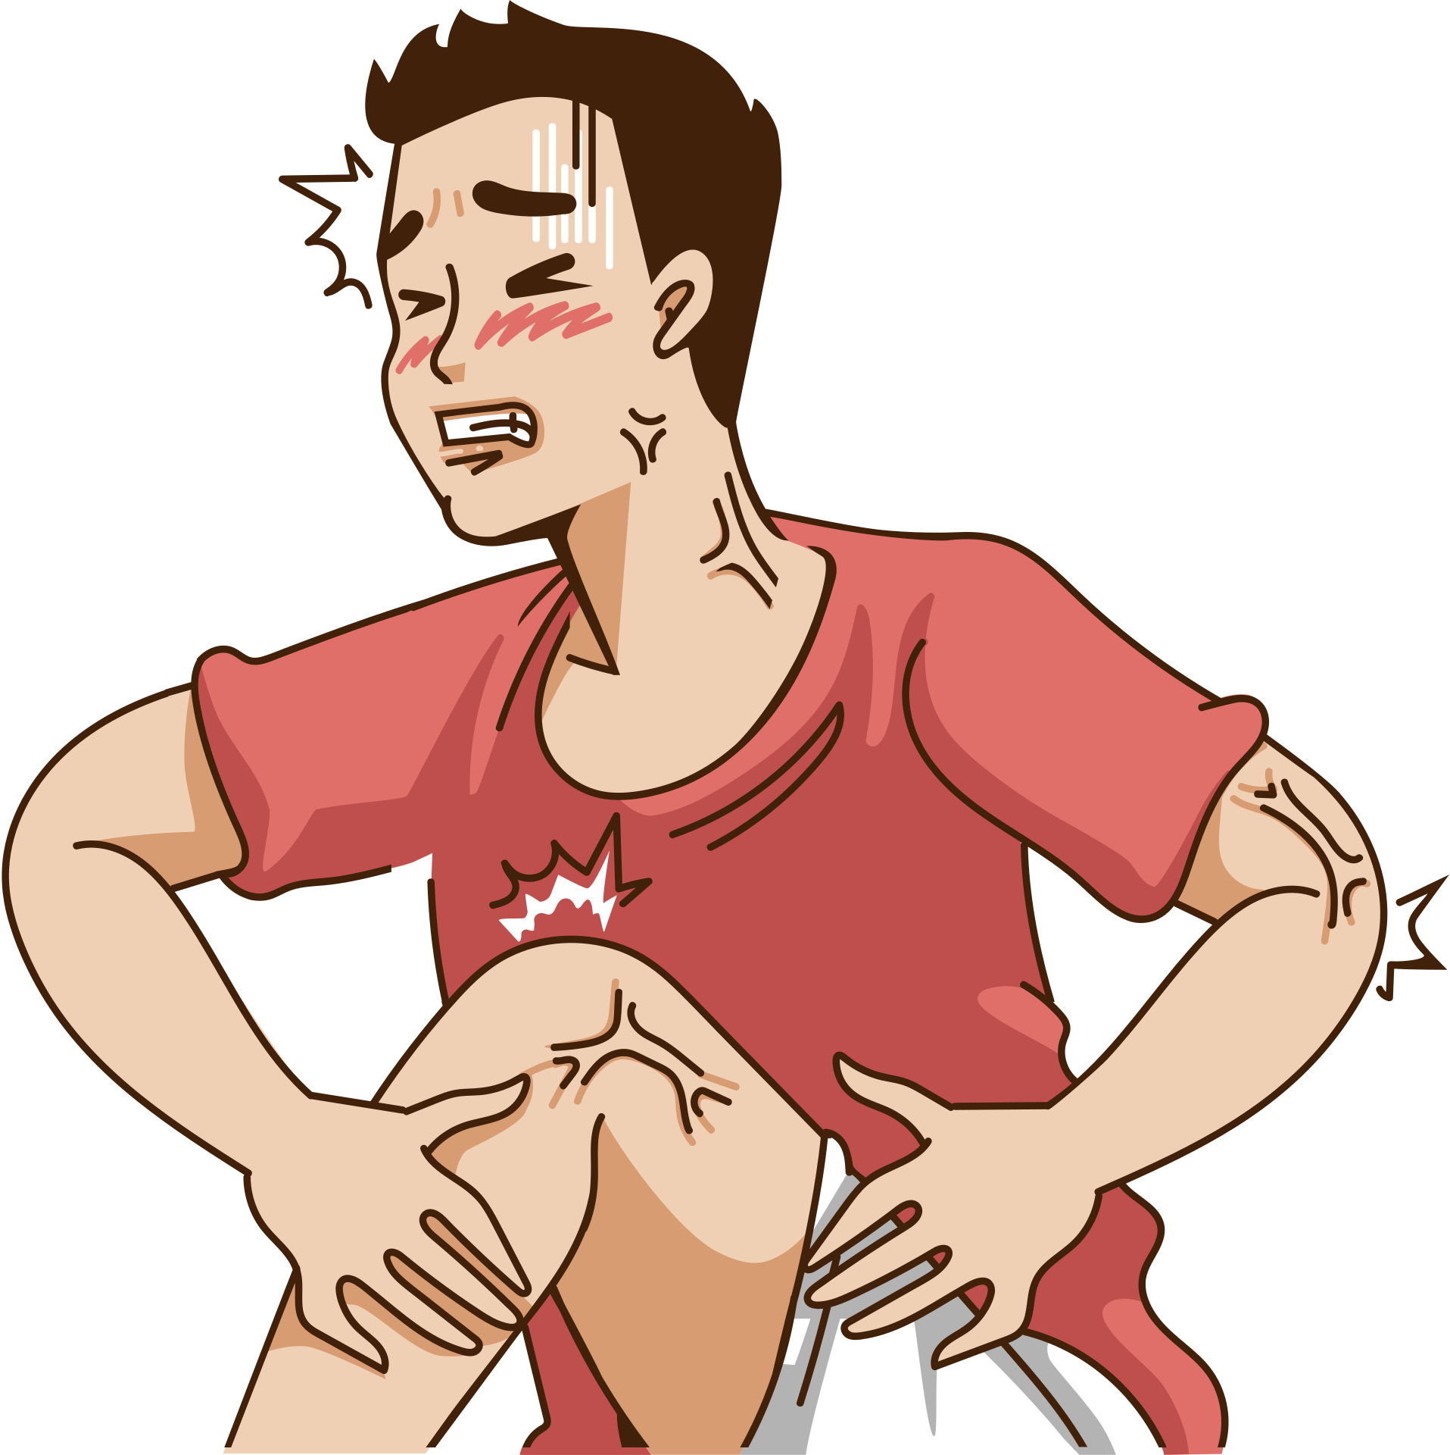
Medicologi.com
HOW YOU FEEL WHEN YOU HAVE SYMPTOMS?
Typhoid
Fever
HeadAche
Fatigue
Stomach Pain
Muscle Pain

Slide 4
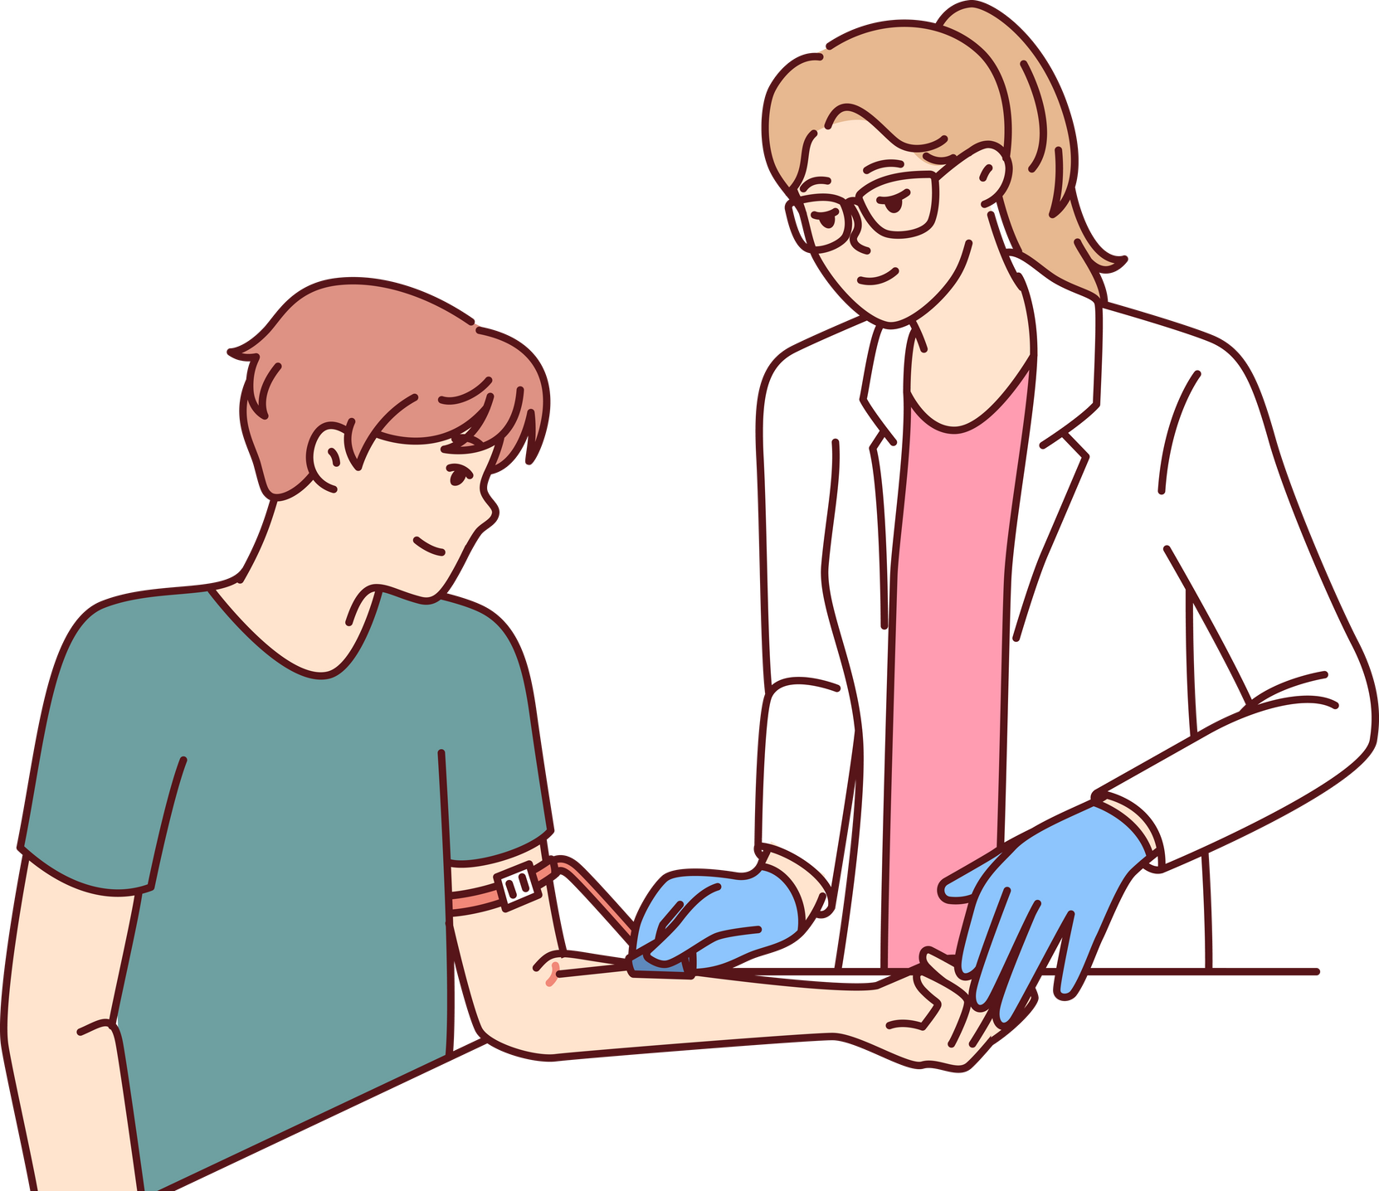

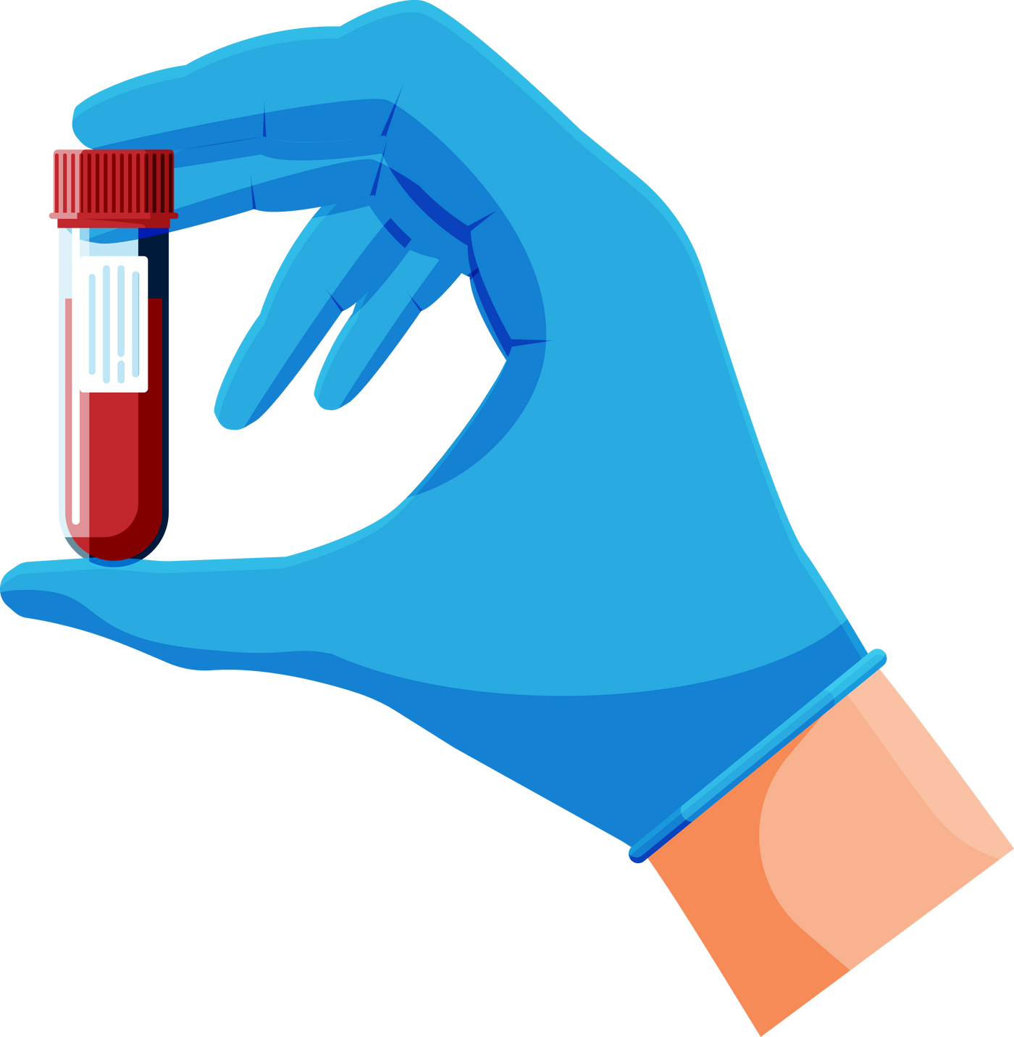
Medicologi.com
DIAGNOSTIC TESTS IN TYPHOID
Widal Test

Slide 5

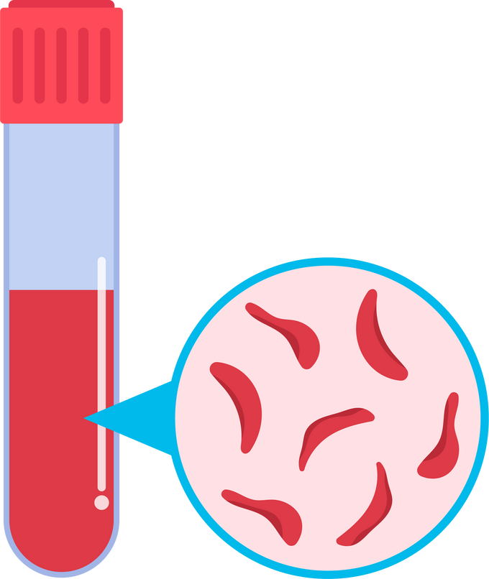
CBC TEST ( COMPLETE BLOOD COUNT )
Medicologi.com
CBC Test
“Different infections can have diverse effects on blood cells. Additionally, other non-infectious causes of fever may not significantly impact blood cell counts”

Slide 6




Medicologi.com
HOW DOCTORS HELP TO CURE TYPHOID FEVER?
Treatment

Slide 7








HOW TO AVOID GETTING TYPHOID FEVER
Medicologi.com
Precautions

Slide 8

Medicologi.com
FINAL WORDS
Summary
Typhoid fever is a serious illness that needs to be treated right away. If you think you might have typhoid fever, you should go to a doctor as soon as you can. With the right treatment, you can get better. And by taking some simple steps, you can avoid getting typhoid fever in the first place. Stay safe and healthy!.

